Slide 1
Greedy Algorithm

Slide 2
Greedy algorithms
A greedy algorithm always makes the choice that looks best at the moment
  My everyday examples:
    Driving in Los Angeles, NY, or Boston for that matter
    Playing cards
    Invest on stocks
    Choose a university
  The hope: a locally optimal choice will lead to a globally optimal solution
  For some problems, it works
greedy algorithms tend to be easier to code

Slide 3
An Activity Selection Problem
(Conference Scheduling Problem)
Input: A set of activities S = {a₁,…, a_{n}}
Each activity has start time and a finish time
  a_{i}=(s_{i}, f_{i})
Two activities are compatible if and only if their interval does not overlap
Output: a maximum-size subset of mutually compatible activities

Slide 4
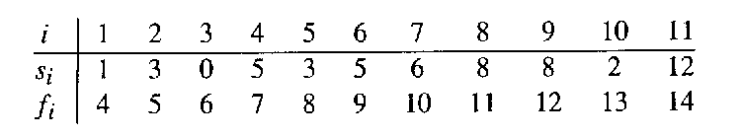
The Activity Selection Problem
Here are a set of start and finish times
What is the maximum number of activities that can be completed?
  {a₃, a₉, a₁₁} can be completed
  But so can {a₁, a₄, a_{8’} a₁₁} which is a larger set
  But it is not unique, consider {a₂, a₄, a_{9’} a₁₁}

Slide 5
Interval Representation

Slide 6
0 1 2 3 4 5 6 7 8 9 10 11 12 13 14 15

Slide 7
Greedy algorithms
S_{ij} the set of activities that start after activity a_{i} finishes and that finish before activity a_{j} starts.
Mutually exclusive maximum set is A_{ij} which includes some activity a_{k}.
|A_{ij} |=| A_{ik} |+| A_{kj} |+1
C[i, j] = c[i, k] + c[k, j] + 1

Slide 8
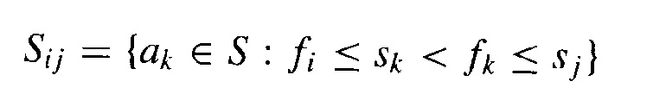
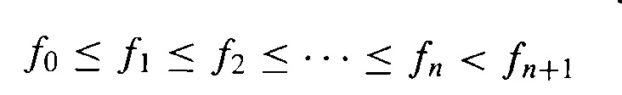
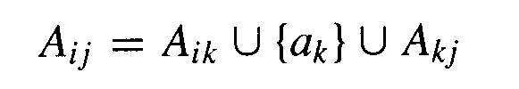
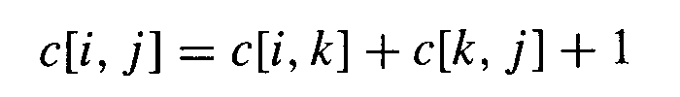
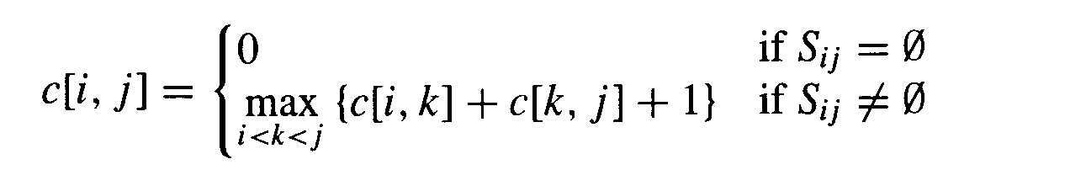
Optimal substructures
Define the following subset of activities which are activities that can start after a_{i} finishes and finish before a_{j} starts
Sort the activities according to finish time
We now define the the maximal set of activities from i to j as
Let c[i,j] be the maximal number of activities
Our recurrence relation for finding c[i, j] becomes
We can solve this using dynamic programming, but a simpler approach exists

Slide 9
Can we make a greedy choice
Choosing the activity which starts early
Choosing the activity which finishes early
Choosing the activity which is of smallest duration
  Intuition suggests that we should choose an activity that leaves the resource available for as many other activities as possible

Slide 10
Can we make a greedy choice
Now, of the activities we end up choosing, one of them must be the first one to finish
In other words, since the activities are sorted in monotonically increasing order by finish time, the greedy choice is activity a₁.

Slide 11
Early Finish Greedy
Select the activity with the earliest finish
Eliminate the activities that could not be scheduled
Repeat!

Slide 12
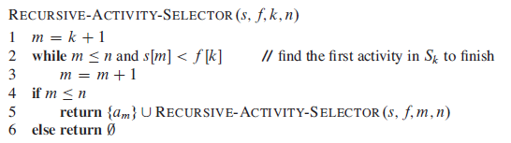
The initial call, which solves the entire problem, is
RECURSIVE-ACTIVITY-SELECTOR(s,f,0,n).

Slide 13
0 1 2 3 4 5 6 7 8 9 10 11 12 13 14 15

Slide 14
0 1 2 3 4 5 6 7 8 9 10 11 12 13 14 15

Slide 15
0 1 2 3 4 5 6 7 8 9 10 11 12 13 14 15

Slide 16
0 1 2 3 4 5 6 7 8 9 10 11 12 13 14 15

Slide 17
0 1 2 3 4 5 6 7 8 9 10 11 12 13 14 15

Slide 18
0 1 2 3 4 5 6 7 8 9 10 11 12 13 14 15

Slide 19
0 1 2 3 4 5 6 7 8 9 10 11 12 13 14 15

Slide 20
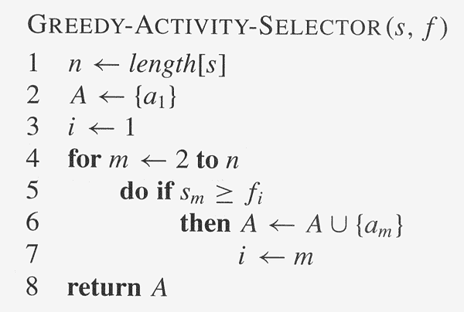
Assuming activities are sorted by finish time

Slide 21
Why it is Greedy?
Greedy in the sense that it leaves as much opportunity as possible for the remaining activities to be scheduled
The greedy choice is the one that maximizes the amount of unscheduled time remaining

Slide 22
Why this Algorithm is Optimal?
We will show that this algorithm uses the following properties
  The problem has the optimal substructure property
  The algorithm satisfies the greedy-choice property
Thus, it is Optimal

Slide 23
Greedy-Choice Property
Show there is an optimal solution that begins with a greedy choice (with activity 1, which as the earliest finish time)
Suppose A ⊆ S in an optimal solution
  Order the activities in A by finish time. The first activity in A is k
    If k = 1, the schedule A begins with a greedy choice
    If k ≠ 1, show that there is an optimal solution B to S that begins with the greedy choice, activity 1
  Let B = A – {k} ∪ {1}
    f₁ ≤ f_{k} → activities in B are disjoint (compatible)
    B has the same number of activities as A
    Thus, B is optimal

Slide 24
Optimal Substructures
  Once the greedy choice of activity 1 is made, the problem reduces to finding an optimal solution for the activity-selection problem over those activities in S that are compatible with activity 1
    Optimal Substructure
    If A is optimal to S, then A’ = A – {1} is optimal to S’={i ∈S: s_{i} ≥ f₁}
    Why?
      If we could find a solution B’ to S’ with more activities than A’, adding activity 1 to B’ would yield a solution B to S with more activities than A ➔ contradicting the optimality of A
  After each greedy choice is made, we are left with an optimization problem of the same form as the original problem
    By induction on the number of choices made, making the greedy choice at every step produces an optimal solution

Slide 25
Elements of Greedy Strategy
An greedy algorithm makes a sequence of choices, each of the choices that seems best at the moment is chosen
  NOT always produce an optimal solution
Two ingredients that are exhibited by most problems that lend themselves to a greedy strategy
  Greedy-choice property
  Optimal substructure

Slide 26
Greedy-Choice Property
A globally optimal solution can be arrived at by making a locally optimal (greedy) choice
  Make whatever choice seems best at the moment and then solve the sub-problem arising after the choice is made
  The choice made by a greedy algorithm may depend on choices so far, but it cannot depend on any future choices or on the solutions to sub-problems
Of course, we must prove that a greedy choice at each step yields a globally optimal solution

Slide 27
Optimal Substructures
A problem exhibits optimal substructure if an optimal solution to the problem contains within it optimal solutions to sub-problems
  If an optimal solution A to S begins with activity 1, then A’ = A – {1} is optimal to S’={i ∈S: s_{i} ≥ f₁}

Slide 28
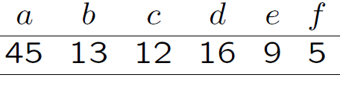
Huffman Coding
Suppose that we have a 100, 000 character data file that we wish to store . The file contains only 6 characters, appearing with the following frequencies:
We would like to find a binary code that encodes the file using as few bits as possible.

Slide 29
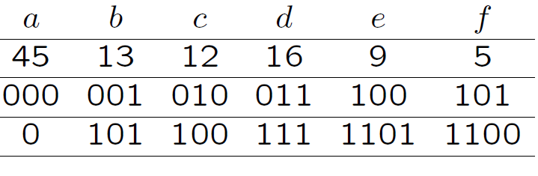
We can encode using two schemes
  fixed-length code
  variable-length code
The fixed length-code requires 300, 000 bits to store the file. The variable-length code uses only
(45.1+13.3+12.3+16.3+9.4+5.4).1000 = 224, 000 bits,
a code will be a set of codewords
{000; 001; 010; 011; 100; 101}
and {0; 101; 100; 111; 1101; 1100}

Slide 30
a code will be a set of codewords
{000; 001; 010; 011; 100; 101}
and {0; 101; 100; 111; 1101; 1100}

Slide 31
Encoding
Given a code (corresponding to some alphabet Γ) and a message it is easy to encode the message. Just replace the characters by the codewords.
Example: Γ = {a; b; c; d}
If the code is C1{a= 00; b = 01; c = 10; d = 11}:
then bad is encoded into 010011
If the code is C2 {a = 0; b = 110; c = 10; d = 111}
then bad is encoded into 1100111

Slide 32
Decoding
Given an encoded message, decoding is the process of turning it back into the original message
C1{a= 00; b = 01; c = 10; d = 11}
C2 {a = 0; b = 110; c = 10; d = 111}
C3 {a = 1; b = 110; c = 10; d = 111}
C1: 010011 is uniquely decodable to bad
C2: 1100111 is uniquely decodable to bad
C3: 1101111 is not uniquely decodable to bad, It can be decoded to (acad, acda, acaaaa, bad, bda)

Slide 33
Prefix-Codes
Prefix Code: A code is called a prefix (free) code if no codeword is a prefix of another one.
Example: {a = 0; b = 110; c = 10; d = 111} is a prefix code.
It is always uniquely decodable.

Slide 34
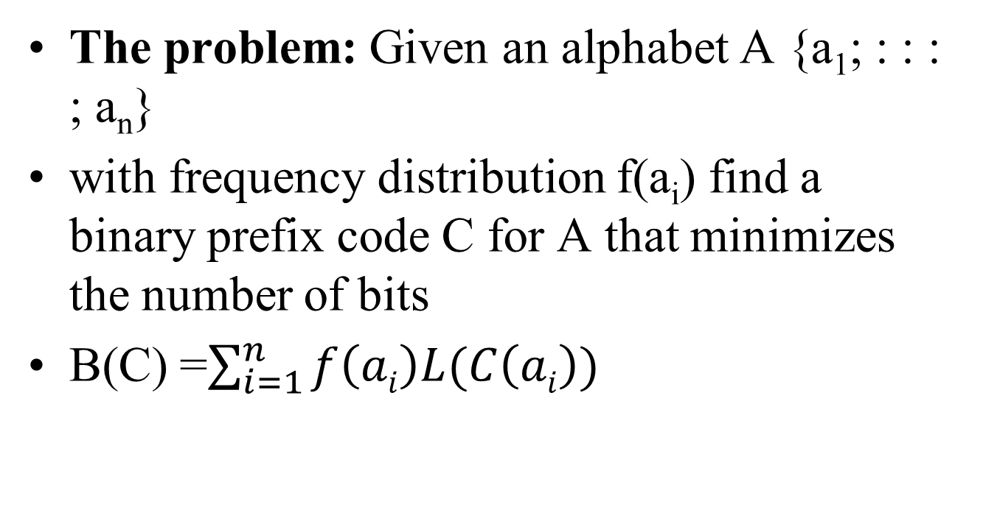
Optimum Source Coding Problem

Slide 35
Building a Tree
Scan the original text
Eerie eyes seen near lake.
What is the frequency of each character in the text?
Char | Freq | Char | Freq
E | 1 | s | 2
e | 8 | n | 2
r | 2 | a | 2
i | 1 | l | 1
space | 4 | k | 1
y | 1 | . | 1
Notes:
An Introduction to Huffman Coding
March 21, 2000
Mike Scott

Slide 36
Building Tree
Pick two letters x; y from alphabet A with the smallest frequencies and create a subtree that has these two characters as leaves. (greedy idea)
Label the root of this subtree as z.
Set frequency f(z) = f(x)+f(y).
Remove x; y and add z creating new alphabet
A’ = A U {z} – {x, y}
Note that |A’| = |A| - 1.

Slide 37
Building a Tree
E
1
i
1
y
1
l
1
k
1
.
1
r
2
s
2
n
2
a
2
sp
4
e
8
Notes:
An Introduction to Huffman Coding
March 21, 2000
Mike Scott

Slide 38
Building a Tree
y
1
l
1
k
1
.
1
r
2
s
2
n
2
a
2
sp
4
e
8
2
E
1
i
1
Notes:
An Introduction to Huffman Coding
March 21, 2000
Mike Scott

Slide 39
Building a Tree
y
1
l
1
k
1
.
1
r
2
s
2
n
2
a
2
2
sp
4
e
8
E
1
i
1
Notes:
An Introduction to Huffman Coding
March 21, 2000
Mike Scott

Slide 40
Building a Tree
k
1
.
1
r
2
s
2
n
2
a
2
2
sp
4
e
8
E
1
i
1
2
y
1
l
1
Notes:
An Introduction to Huffman Coding
March 21, 2000
Mike Scott

Slide 41
Building a Tree
k
1
.
1
r
2
s
2
n
2
a
2
2
2
sp
4
e
8
y
1
l
1
E
1
i
1
Notes:
An Introduction to Huffman Coding
March 21, 2000
Mike Scott

Slide 42
Building a Tree
r
2
s
2
n
2
a
2
2
2
sp
4
e
8
y
1
l
1
E
1
i
1
2
k
1
.
1
Notes:
An Introduction to Huffman Coding
March 21, 2000
Mike Scott

Slide 43
Building a Tree
r
2
s
2
n
2
a
2
2
2
sp
4
e
8
2
E
1
i
1
y
1
l
1
k
1
.
1
Notes:
An Introduction to Huffman Coding
March 21, 2000
Mike Scott

Slide 44
Building a Tree
n
2
a
2
2
sp
4
e
8
2
2
E
1
i
1
y
1
l
1
k
1
.
1
4
r
2
s
2
Notes:
An Introduction to Huffman Coding
March 21, 2000
Mike Scott

Slide 45
Building a Tree
n
2
a
2
2
sp
4
e
8
2
2
4
E
1
i
1
y
1
l
1
k
1
.
1
r
2
s
2
Notes:
An Introduction to Huffman Coding
March 21, 2000
Mike Scott

Slide 46
Building a Tree
2
4
e
8
2
2
sp
4
y
1
l
1
k
1
.
1
r
2
s
2
E
1
i
1
4
n
2
a
2
Notes:
An Introduction to Huffman Coding
March 21, 2000
Mike Scott

Slide 47
Building a Tree
2
4
4
e
8
2
2
sp
4
y
1
l
1
k
1
.
1
r
2
s
2
n
2
a
2
E
1
i
1
Notes:
An Introduction to Huffman Coding
March 21, 2000
Mike Scott

Slide 48
Building a Tree
4
4
e
8
2
sp
4
k
1
.
1
r
2
s
2
n
2
a
2
4
2
2
E
1
i
1
y
1
l
1
Notes:
An Introduction to Huffman Coding
March 21, 2000
Mike Scott

Slide 49
Building a Tree
2
4
4
4
sp
4
e
8
2
2
k
1
.
1
r
2
s
2
n
2
a
2
E
1
i
1
y
1
l
1
Notes:
An Introduction to Huffman Coding
March 21, 2000
Mike Scott

Slide 50
Building a Tree
4
4
4
e
8
2
2
r
2
s
2
n
2
a
2
E
1
i
1
y
1
l
1
6
2
sp
4
k
1
.
1
Notes:
An Introduction to Huffman Coding
March 21, 2000
Mike Scott

Slide 51
Building a Tree
4
4
4
6
e
8
2
sp
4
r
2
s
2
n
2
a
2
2
2
k
1
.
1
E
1
i
1
y
1
l
1
What is happening to the characters with a low number of occurrences?
Notes:
An Introduction to Huffman Coding
March 21, 2000
Mike Scott

Slide 52
Building a Tree
4
6
e
8
2
2
2
sp
4
E
1
i
1
y
1
l
1
k
1
.
1
8
4
4
r
2
s
2
n
2
a
2
Notes:
An Introduction to Huffman Coding
March 21, 2000
Mike Scott

Slide 53
Building a Tree
4
6
e
8
8
2
2
2
sp
4
4
4
E
1
i
1
y
1
l
1
k
1
.
1
r
2
s
2
n
2
a
2
Notes:
An Introduction to Huffman Coding
March 21, 2000
Mike Scott

Slide 54
Building a Tree
e
8
8
4
4
10
r
2
s
2
n
2
a
2
4
6
2
2
2
sp
4
E
1
i
1
y
1
l
1
k
1
.
1
Notes:
An Introduction to Huffman Coding
March 21, 2000
Mike Scott

Slide 55
Building a Tree
e
8
8
10
4
4
4
6
n
2
a
2
2
2
2
r
2
s
2
sp
4
E
1
i
1
y
1
l
1
k
1
.
1
Notes:
An Introduction to Huffman Coding
March 21, 2000
Mike Scott

Slide 56
Building a Tree
10
16
4
6
2
2
2
e
8
8
sp
4
E
1
i
1
y
1
l
1
k
1
.
1
4
4
r
2
s
2
n
2
a
2
Notes:
An Introduction to Huffman Coding
March 21, 2000
Mike Scott

Slide 57
Building a Tree
10
16
4
6
e
8
8
2
2
2
sp
4
4
4
E
1
i
1
y
1
l
1
k
1
.
1
r
2
s
2
n
2
a
2
Notes:
An Introduction to Huffman Coding
March 21, 2000
Mike Scott

Slide 58
Building a Tree
26
16
10
4
e
8
8
6
2
2
2
sp
4
4
4
E
1
i
1
y
1
l
1
k
1
.
1
r
2
s
2
n
2
a
2
Notes:
An Introduction to Huffman Coding
March 21, 2000
Mike Scott

Slide 59
Building a Tree
After enqueueing this node there is only one node left in priority queue.
26
16
10
4
e
8
8
6
2
2
2
sp
4
4
4
E
1
i
1
y
1
l
1
k
1
.
1
r
2
s
2
n
2
a
2
Notes:
An Introduction to Huffman Coding
March 21, 2000
Mike Scott

Slide 60
Building a Tree
Dequeue the single node left in the queue.
This tree contains the new code words for each character.
Frequency of root node should equal number of characters in text.
26
16
10
4
e
8
8
6
2
2
2
4
sp
4
4
E
1
i
1
y
1
l
1
k
1
.
1
r
2
s
2
n
2
a
2
Eerie eyes seen near lake. 26 characters
Notes:
An Introduction to Huffman Coding
March 21, 2000
Mike Scott

Slide 61
Encoding the File
Traverse Tree for Codes
Perform a traversal of the tree to obtain new code words
Going left is a 0 going right is a 1
code word is only completed when a leaf node is reached
26
16
10
4
e
8
8
6
2
2
2
4
sp
4
4
E
1
i
1
y
1
l
1
k
1
.
1
r
2
s
2
n
2
a
2
Notes:
An Introduction to Huffman Coding
March 21, 2000
Mike Scott

Slide 62
Encoding the File
Traverse Tree for Codes
Char Code
E 0000
i 0001
y 0010
l 0011
k 0100
. 0101
space 011
e 10
r 1100
s 1101
n 1110
a 1111
26
16
10
4
e
8
8
6
2
2
2
4
sp
4
4
E
1
i
1
y
1
l
1
k
1
.
1
r
2
s
2
n
2
a
2
Notes:
An Introduction to Huffman Coding
March 21, 2000
Mike Scott

Slide 63
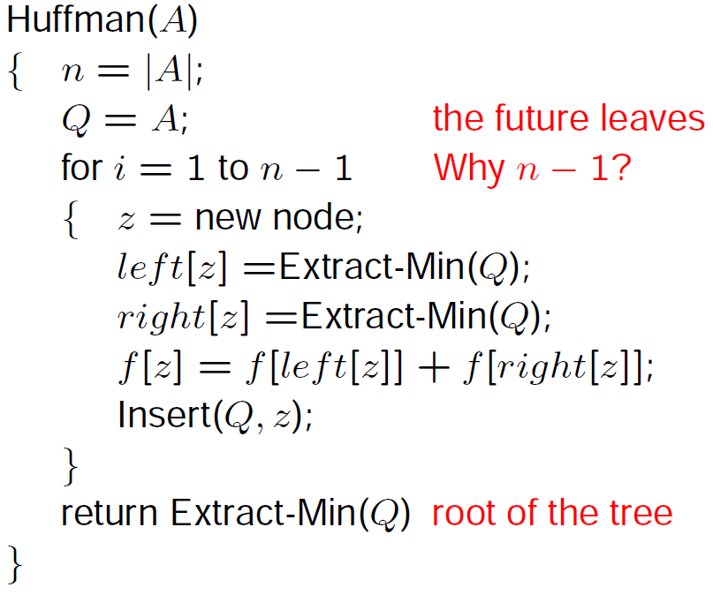
Huffman Coding Algorithm

Slide 64
